Slide 1
















Queens of Soul Website
Jhurney, Destiny, Evelyn
11:11PM

Slide 2



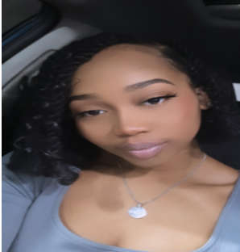

Meet Our Team
Jhurney Hairston
Destiny Henderson
Evelyn Adebayo
Food Enthusiast & DC Native
Food Enthusiast
Food Enthusiast
Back to Agenda Page

Slide 3



Agenda • Agenda • Agenda • Agenda • Agenda • Agenda • Agenda • Agenda • Agenda • Agenda • Agenda • Agenda • Agenda • Agenda
Queens of Soul
Topics Covered
Strategy
Scope and Structure
Skeleton
Agenda
Surface
Implementation and Reflection

Slide 4
Strategy
Purpose:
Highlight and showcase authentic soul food cuisine
Provide essential information such as menu and location
Emphasize the history of the restaurant
Goals:
Focus on special menu items and chefs
Ensure a seamless user-friendly experience
Attract new customers
Back to Agenda Page
Notes:
"Now, let's talk about our strategy for reaching our audience effectively. Our strategy is to spotlight authentic soul food cuisine, provide essential menu and location details, and highlight our restaurant's history. We aim to focus on our unique menu items and chefs while ensuring a seamless user experience to attract new customers."

Slide 5



Target Audience
Primary Audience:
Food enthusiasts
Those who enjoy soul food cuisine
Local residents seeking dining options
Tourists exploring the area
Secondary Audience:
Event planners seeking catering options
Food bloggers or content creators
Individuals interested in working at Queens of Soul
Notes:
"Our primary audience includes food enthusiasts, locals, and tourists, while our secondary audience consists of event planners, bloggers, and potential employees."

Slide 6















Scope and Structure • Scope and Structure • Scope and Structure • Scope and Structure • Scope and Structure • Scope and Structure • Scope and
Scope
and Structure
Back to Agenda Page
Scope and Structure • Scope and Structure • Scope and Structure • Scope and Structure • Scope and Structure • Scope and Structure • Scope an
Notes:
What features are critical for the initial site (a list is all you need here) and how do they relate to one another (an organizational sketch will do nicely)?
Here I'm more interested in seeing this represented not in a "pretty" form, but in a rough form that you did while working out ideas for the site. Including a picture from a quick sketch on paper or whiteboard is enough here -- no need to spend additional time making your scope and structure neat and tidy. The idea here is that this section should be present, but can be "rough" -- convince us you went through this step!
Scope transforms strategy into requirements: What features will the site need to include?
Structure gives shape to scope: How will the pieces of the site fit together and behave?

Slide 7
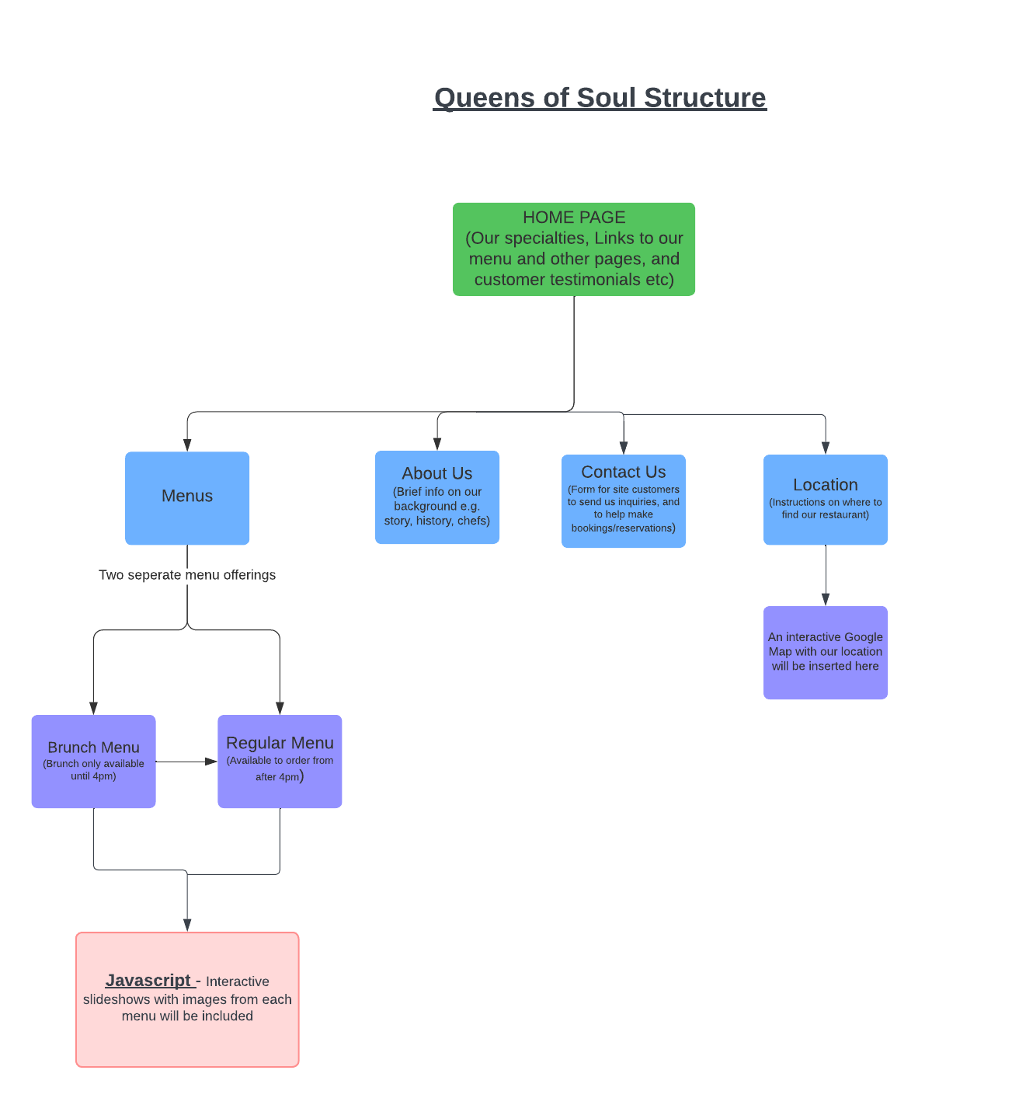
Scope and Structure
This will be the necessary scope of our website:
Home - PAGE 1
Menu - PAGE 2
About Us - PAGE 3
Contact - PAGE 4
Location - PAGE 5
Notes:
At ‘Queens of Soul’ restaurant we want to exhibit and truly showcase our special, unique menu and food excellence to the world. Therefore, it’s essential that our site has a simple user interface that allows site guests and customers to be able to navigate through our site simply and easily be able to acquire the information they are looking for.

Slide 8


Skeleton
Home | Menu | About Us | Contact | Location
Logo | Logo | Our Story | Logo | Logo
Our Specialties | Brunch Menu | Our History | Number | Directions
Pictures of Specialties | Regular Menu | Chefs | Hours of Operation | Link to map
Customer Reviews | Prices | Commitment | Place to leave messages
Awards | Slideshow | Join Us
Back to Agenda Page
Notes:
Home Page:
The home page serves as the digital storefront, welcoming visitors to the Queens of Soul experience.
It features a captivating header with the restaurant's distinctive logo, intuitive navigation menu, and an irresistible call-to-action button to entice exploration.
Engaging sections highlight the essence of Queens of Soul, including its signature dishes, inviting ambiance, and commitment to hospitality.
Social proof elements, such as glowing testimonials and enticing reviews, validate the restaurant's reputation and encourage visitors to embark on a culinary journey with confidence.
Menu Page:
The menu page is a culinary treasure trove, inviting guests to indulge in the soulful flavors of Queens of Soul's authentic cuisine.
It showcases a delectable array of dishes, from beloved classics to innovative creations, each accompanied by tantalizing descriptions and mouthwatering imagery.
Visitors can explore the diverse selection of appetizers, main courses, sides, and desserts, discovering new favorites and savoring the nostalgia of traditional Southern cooking.
A seamless user interface ensures effortless navigation, allowing patrons to effortlessly peruse the menu and plan their dining experience with ease.
About Us Page:
The About Us page offers a glimpse into the rich history and heartfelt mission behind Queens of Soul.
It shares the restaurant's origin story, celebrating its roots in Southern tradition and passion for culinary excellence.
Visitors are introduced to the dedicated team behind the scenes, each member contributing their unique talents and expertise to the restaurant's success.
A compelling narrative highlights Queens of Soul's commitment to community, showcasing its involvement in local initiatives and dedication to serving with integrity and authenticity.
Contact Us Page:
The Contact Us page serves as a direct line of communication between Queens of Soul and its valued guests.
It features a user-friendly contact form, allowing visitors to reach out with inquiries, feedback, or reservation requests effortlessly.
Essential contact information, including phone numbers, email addresses, and physical location, is readily accessible, ensuring prompt and convenient assistance.
Visitors are encouraged to connect with Queens of Soul, whether to plan a special event, share their dining experience, or inquire about upcoming promotions or collaborations.
Location Page:
The Location page provides essential information for patrons seeking to visit Queens of Soul in person.
Interactive maps and detailed directions make it easy for guests to navigate to the restaurant's physical location, ensuring a seamless arrival experience.
Additional details, such as parking availability, public transportation options, and nearby landmarks, help visitors plan their journey with confidence.
Engaging visuals and descriptive imagery capture the essence of the surrounding neighborhood, inviting guests to explore the vibrant community and discover hidden gems beyond the restaurant's doors.

Slide 9

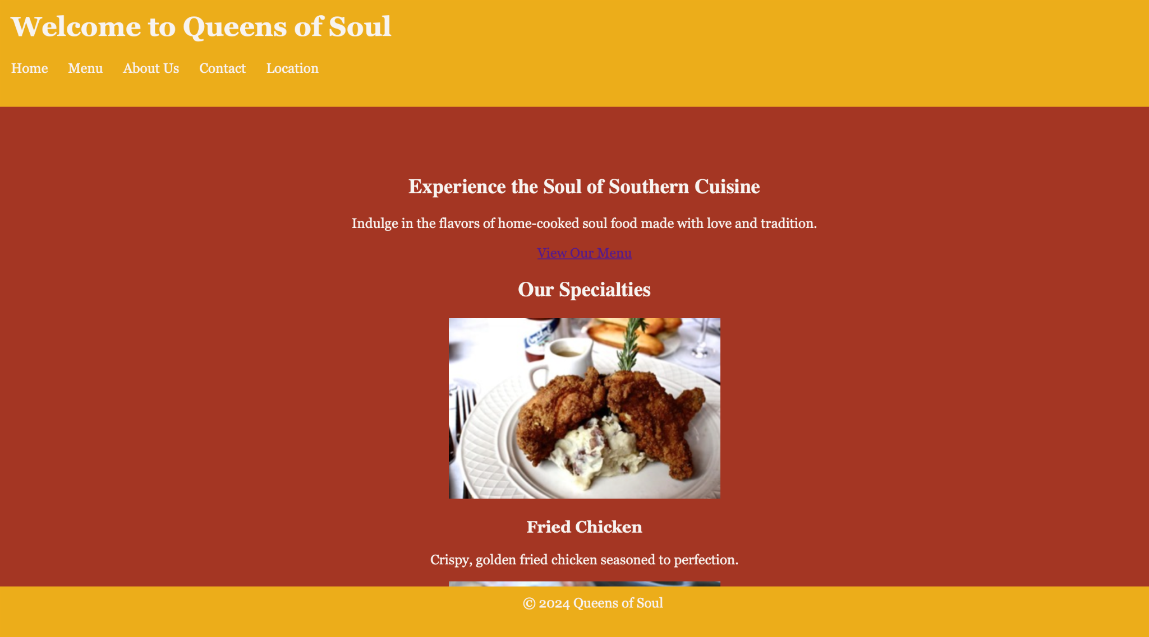
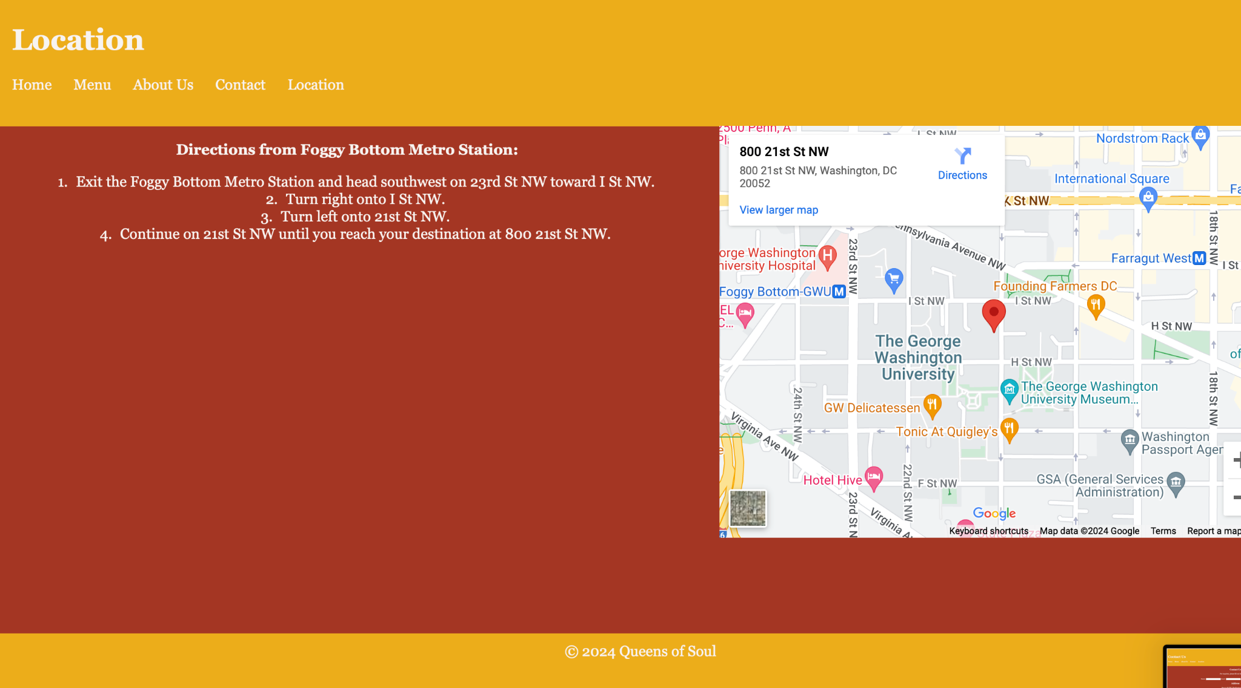


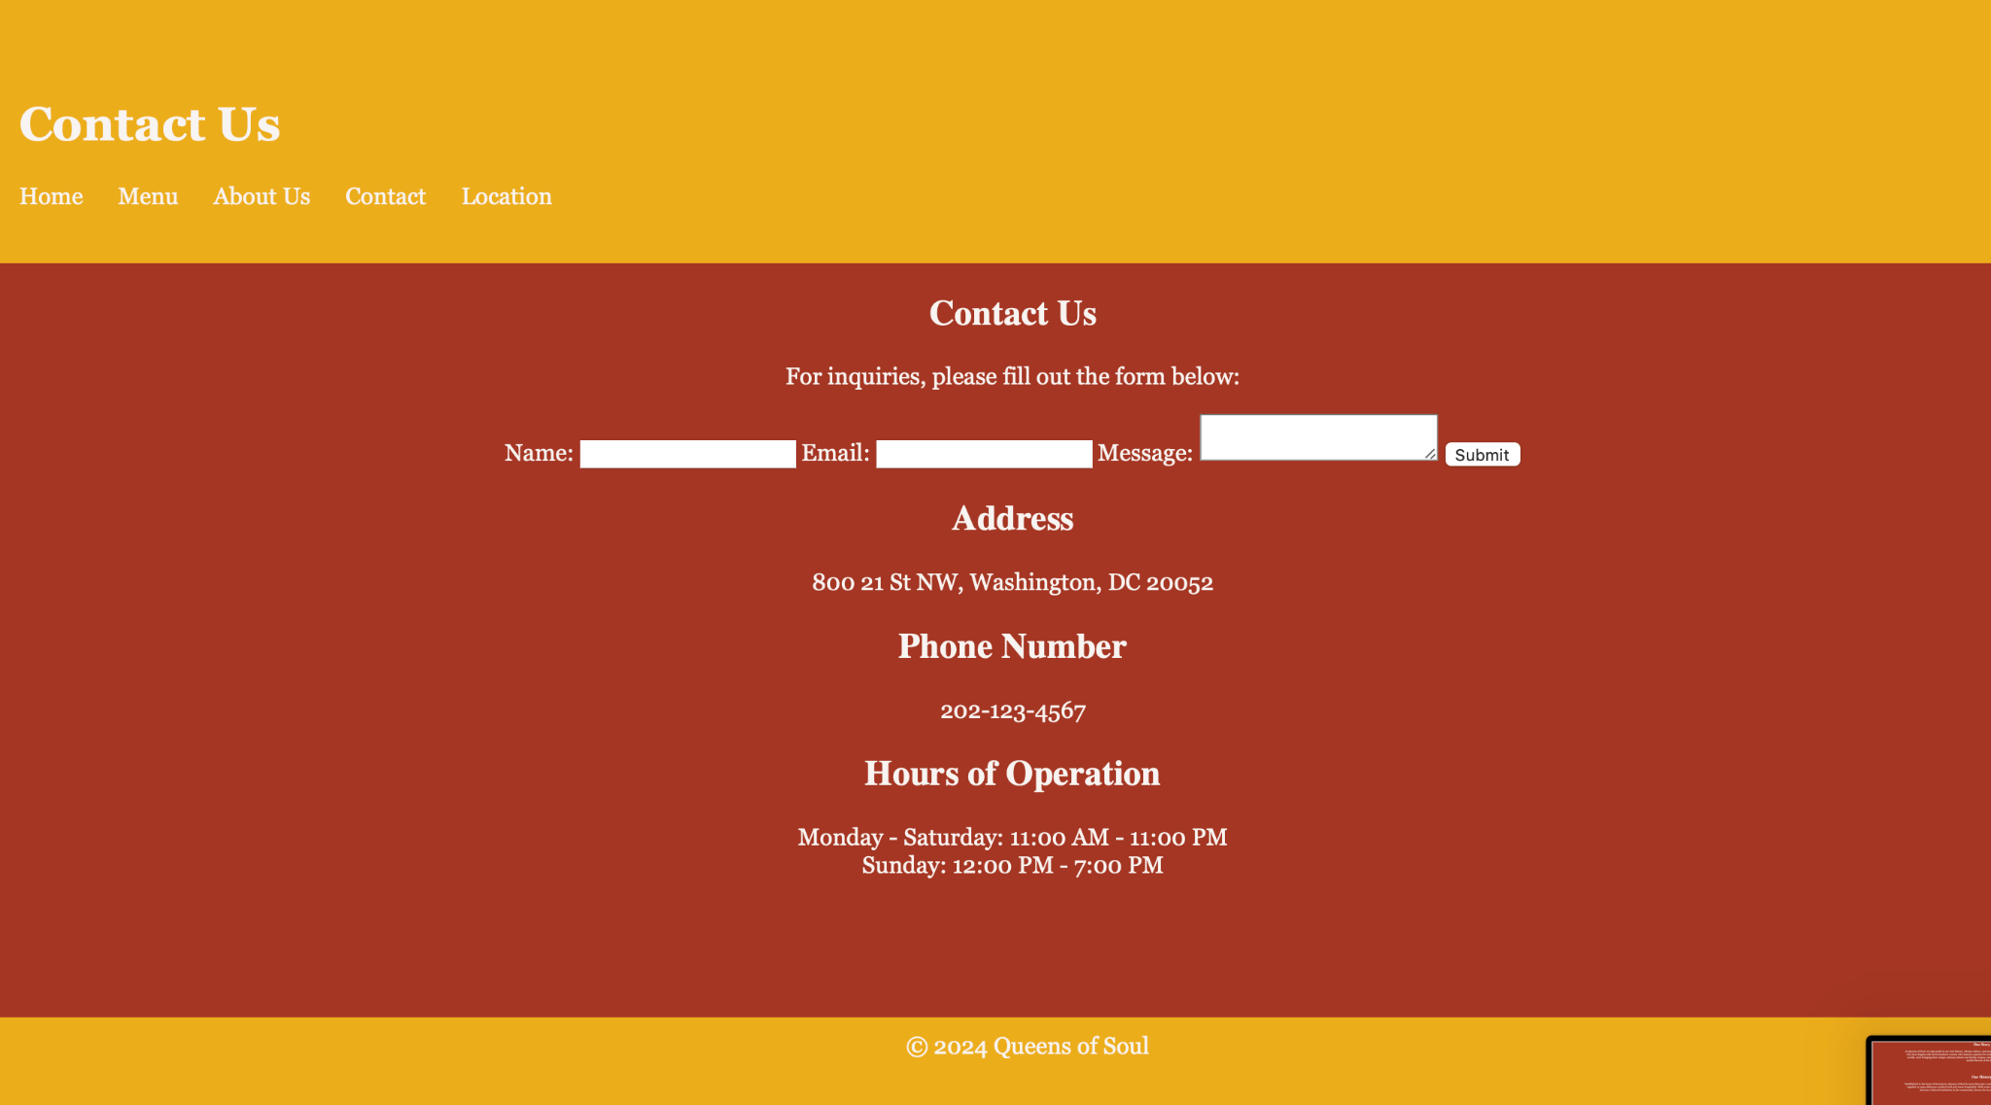
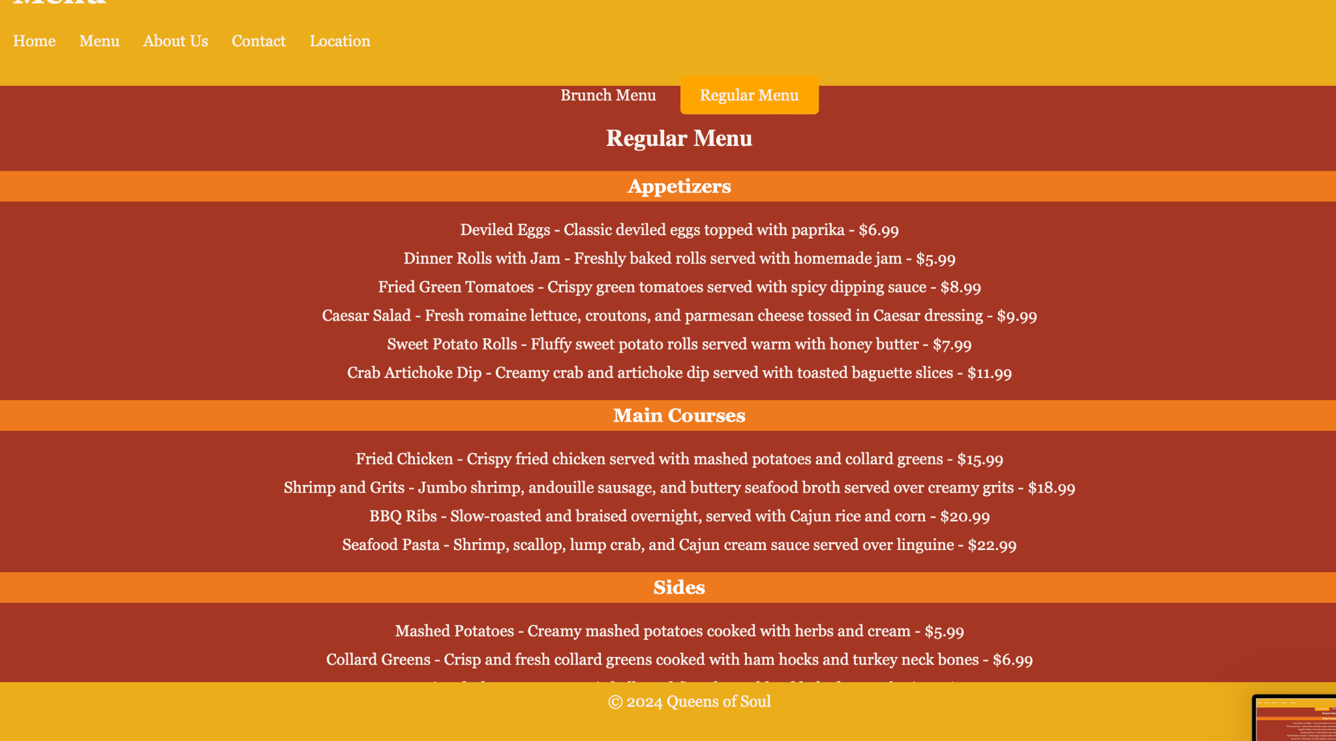
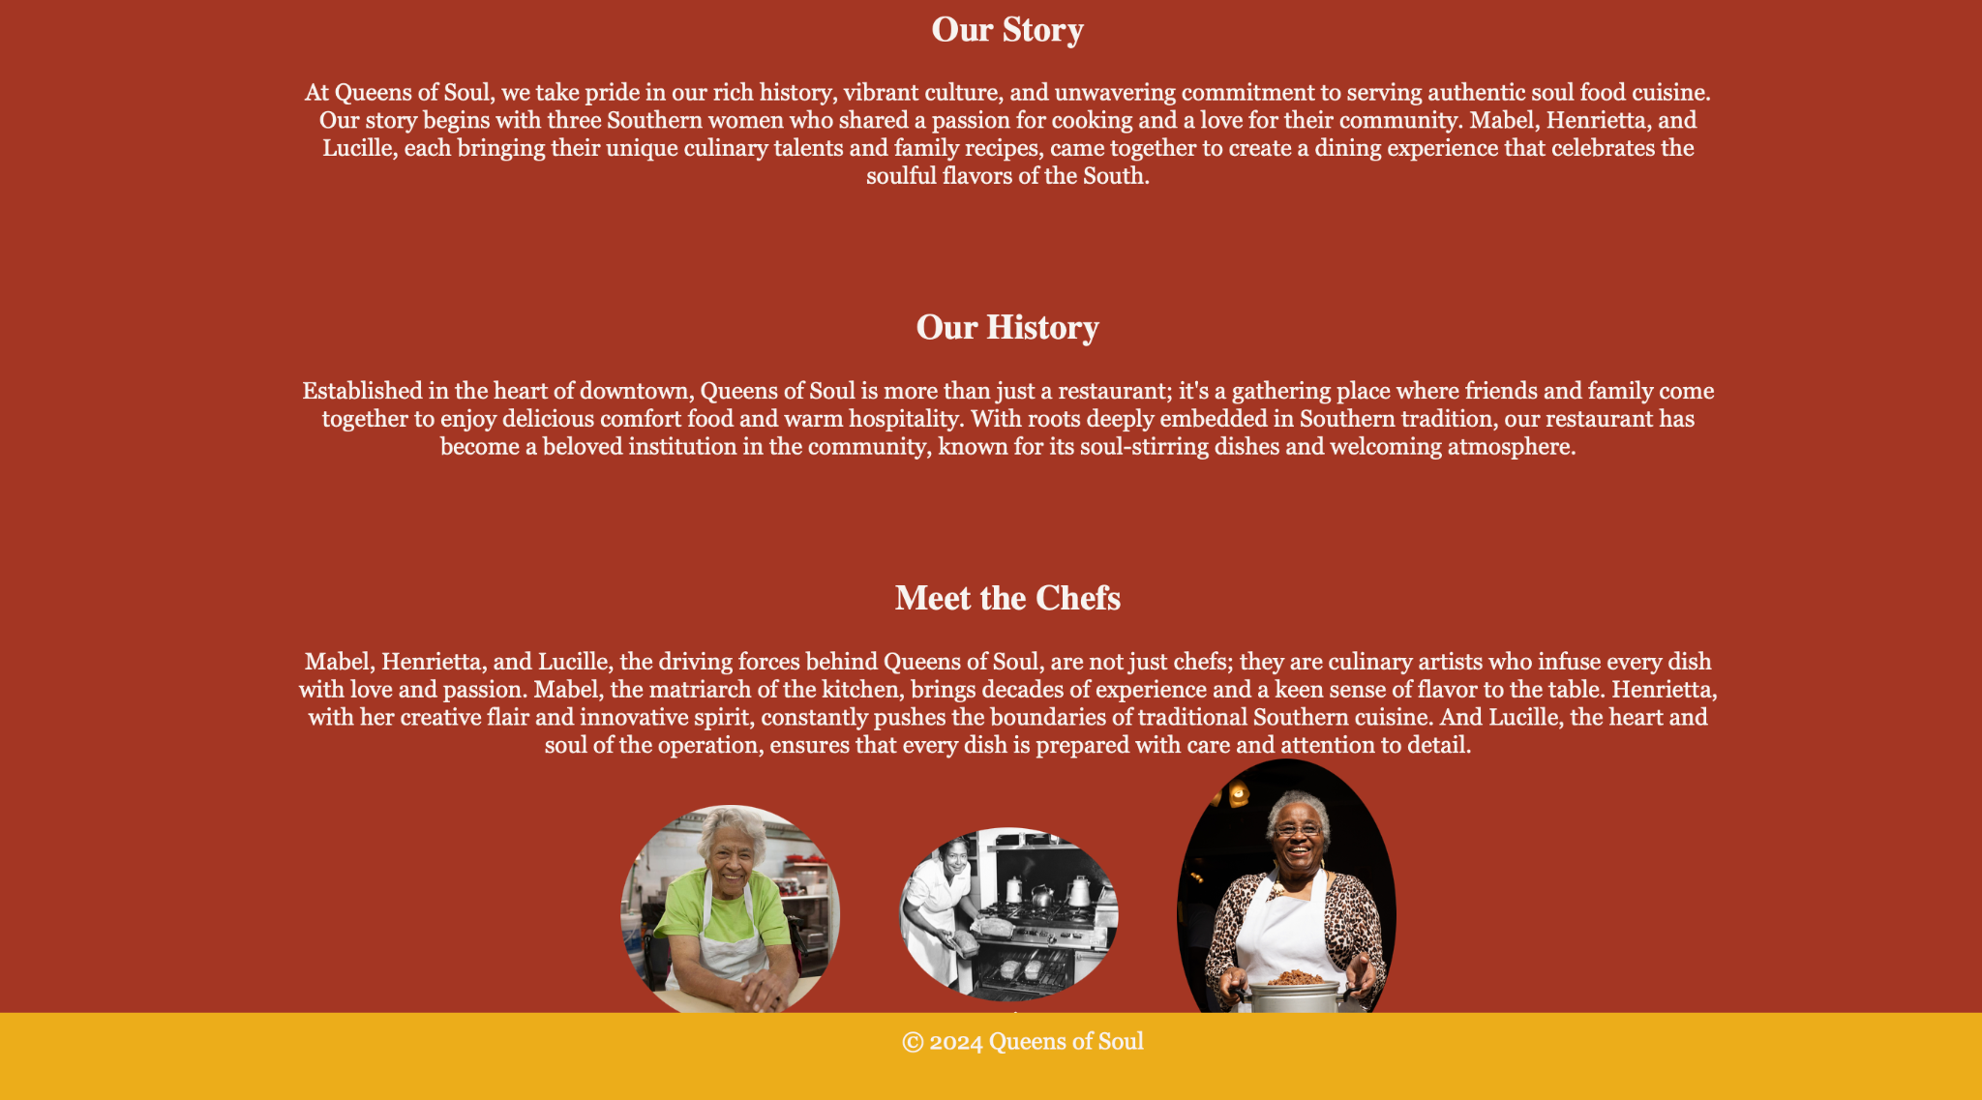
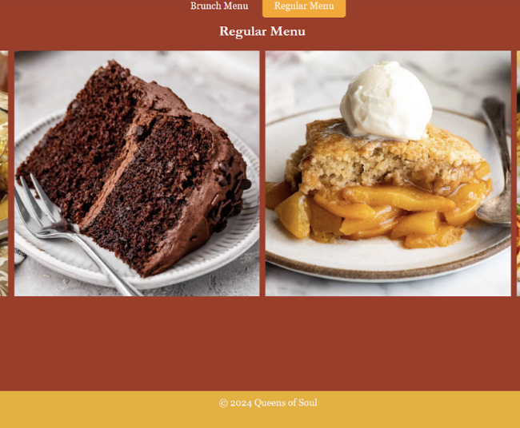

Back to Agenda Page
Surface
Back to Agenda Page
Notes:
Provide one (possibly two if you developed alternatives) Again,including a picture from a quick sketch on paper or whiteboard is enough here -- no need to spend additional time making your skeleton neat and tidy. The idea here is that this section should be present, but can be "rough" -- convince us you went through this step!
Skeleton makes structure concrete: What components will enable people to use the site?

Slide 10
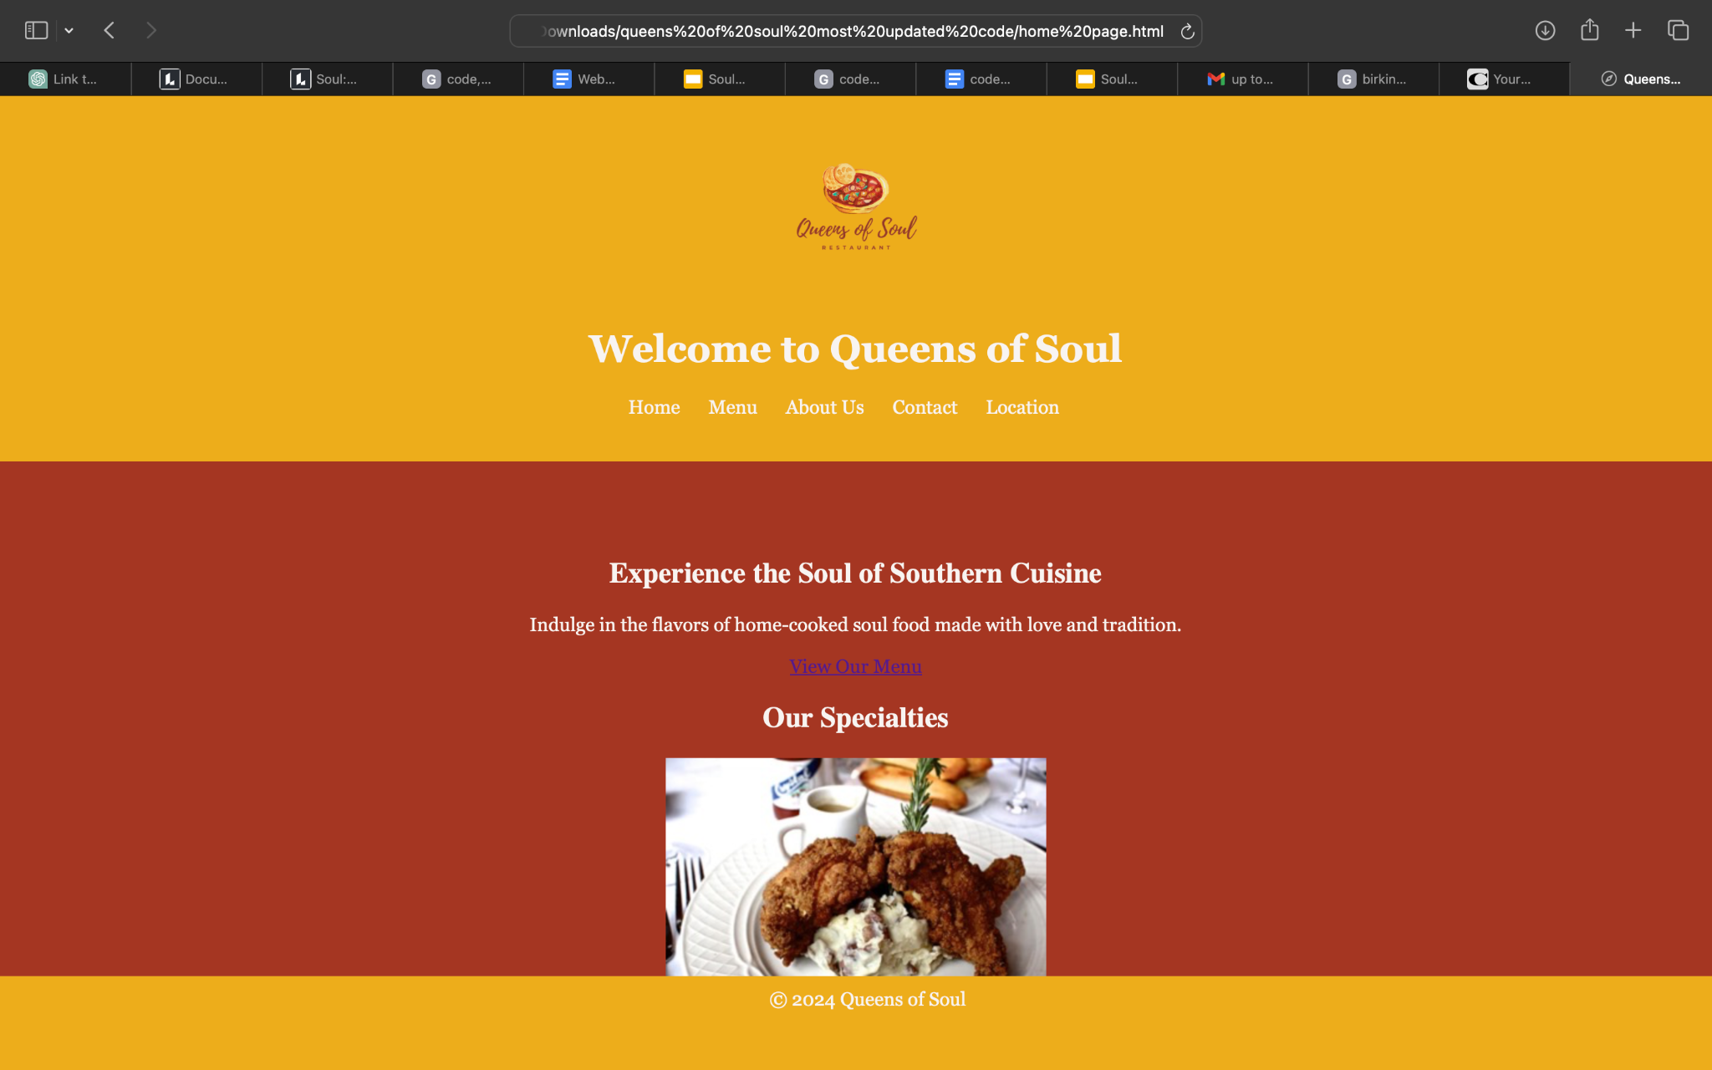
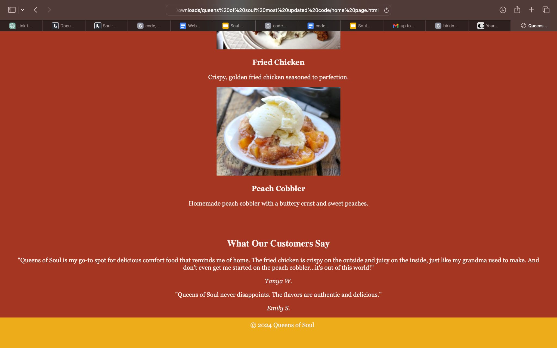
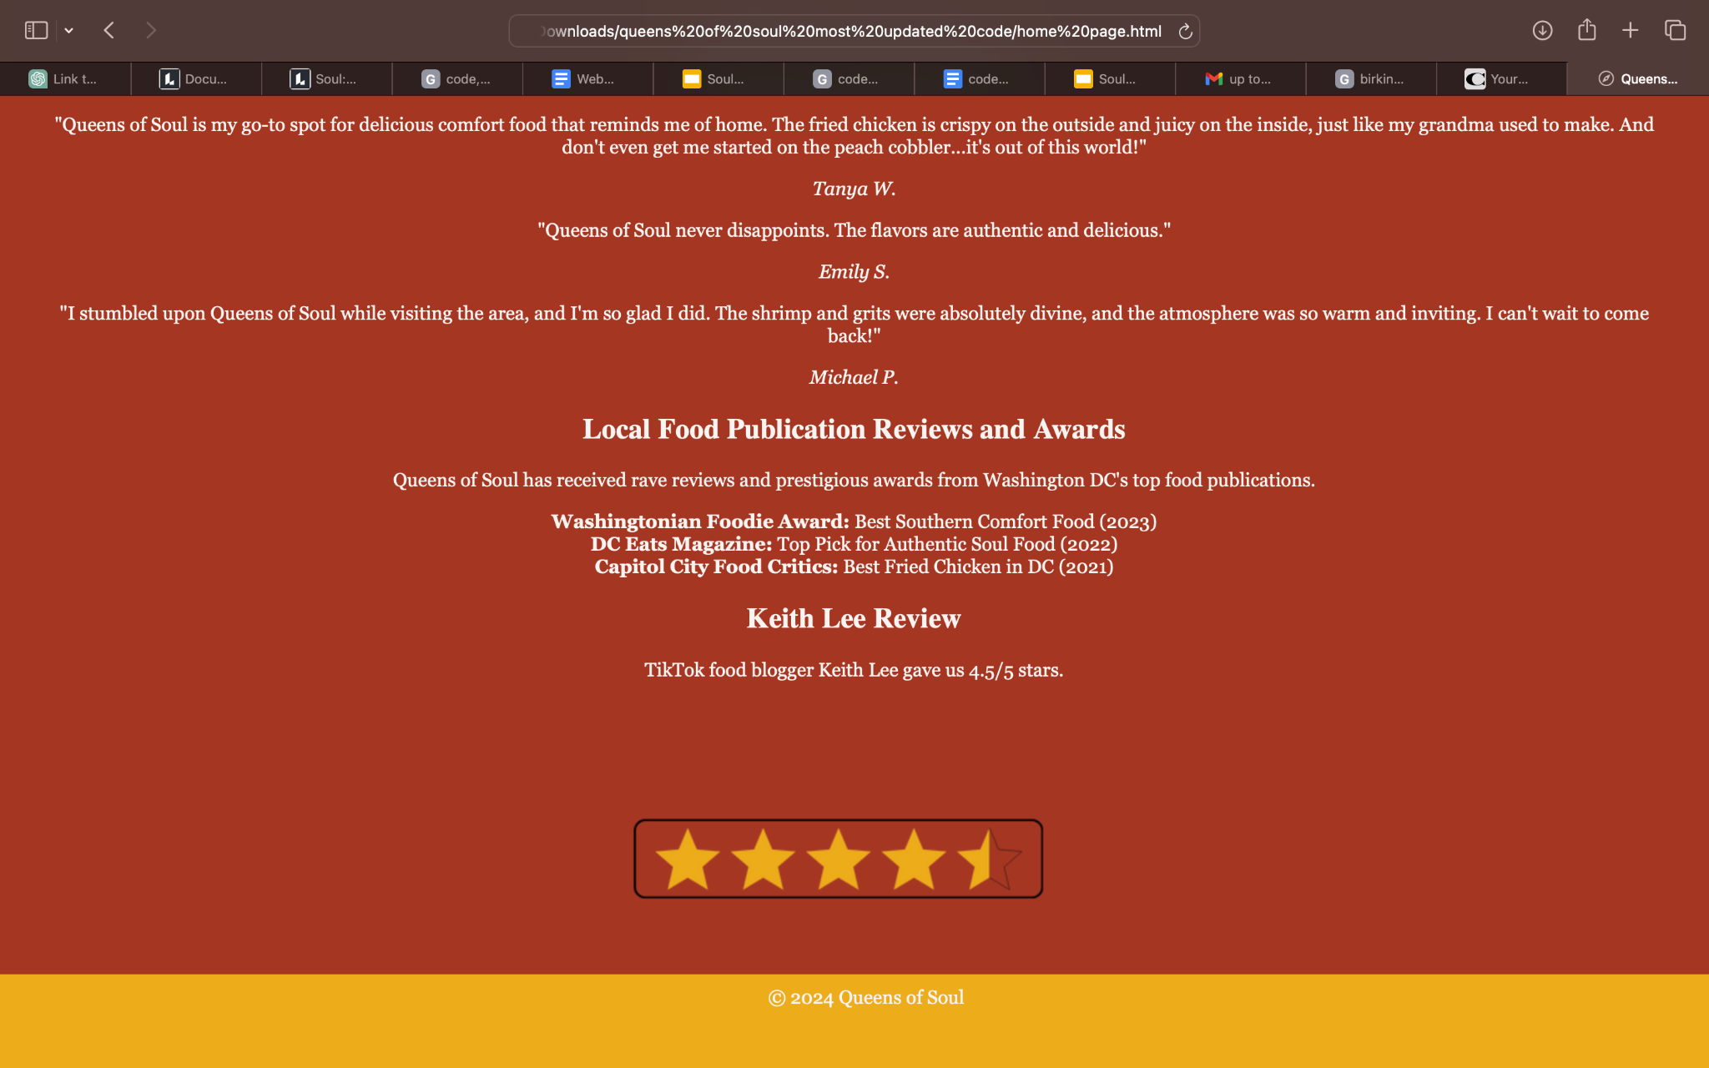
PAGE 1: Home

Slide 11
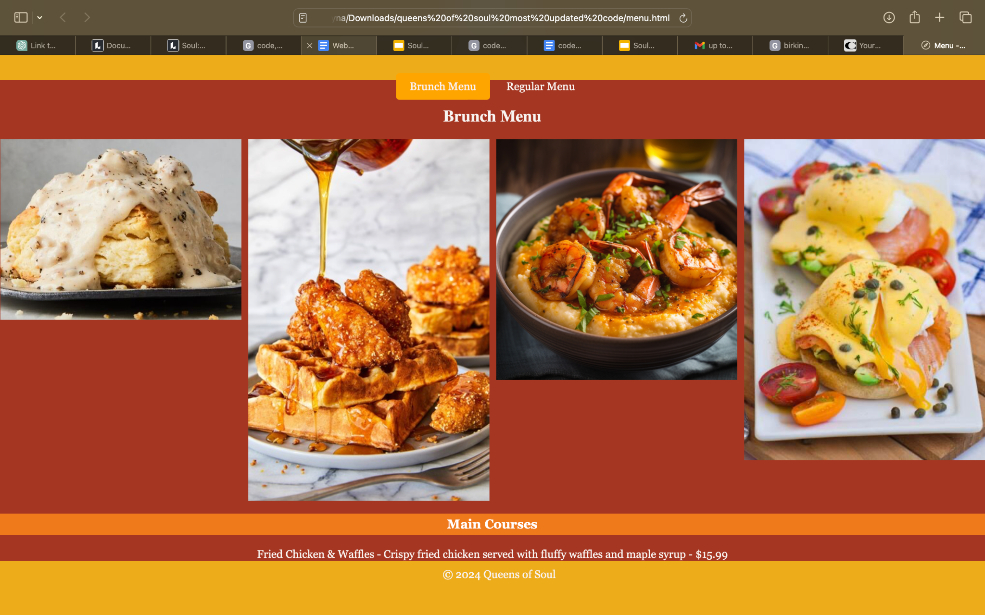
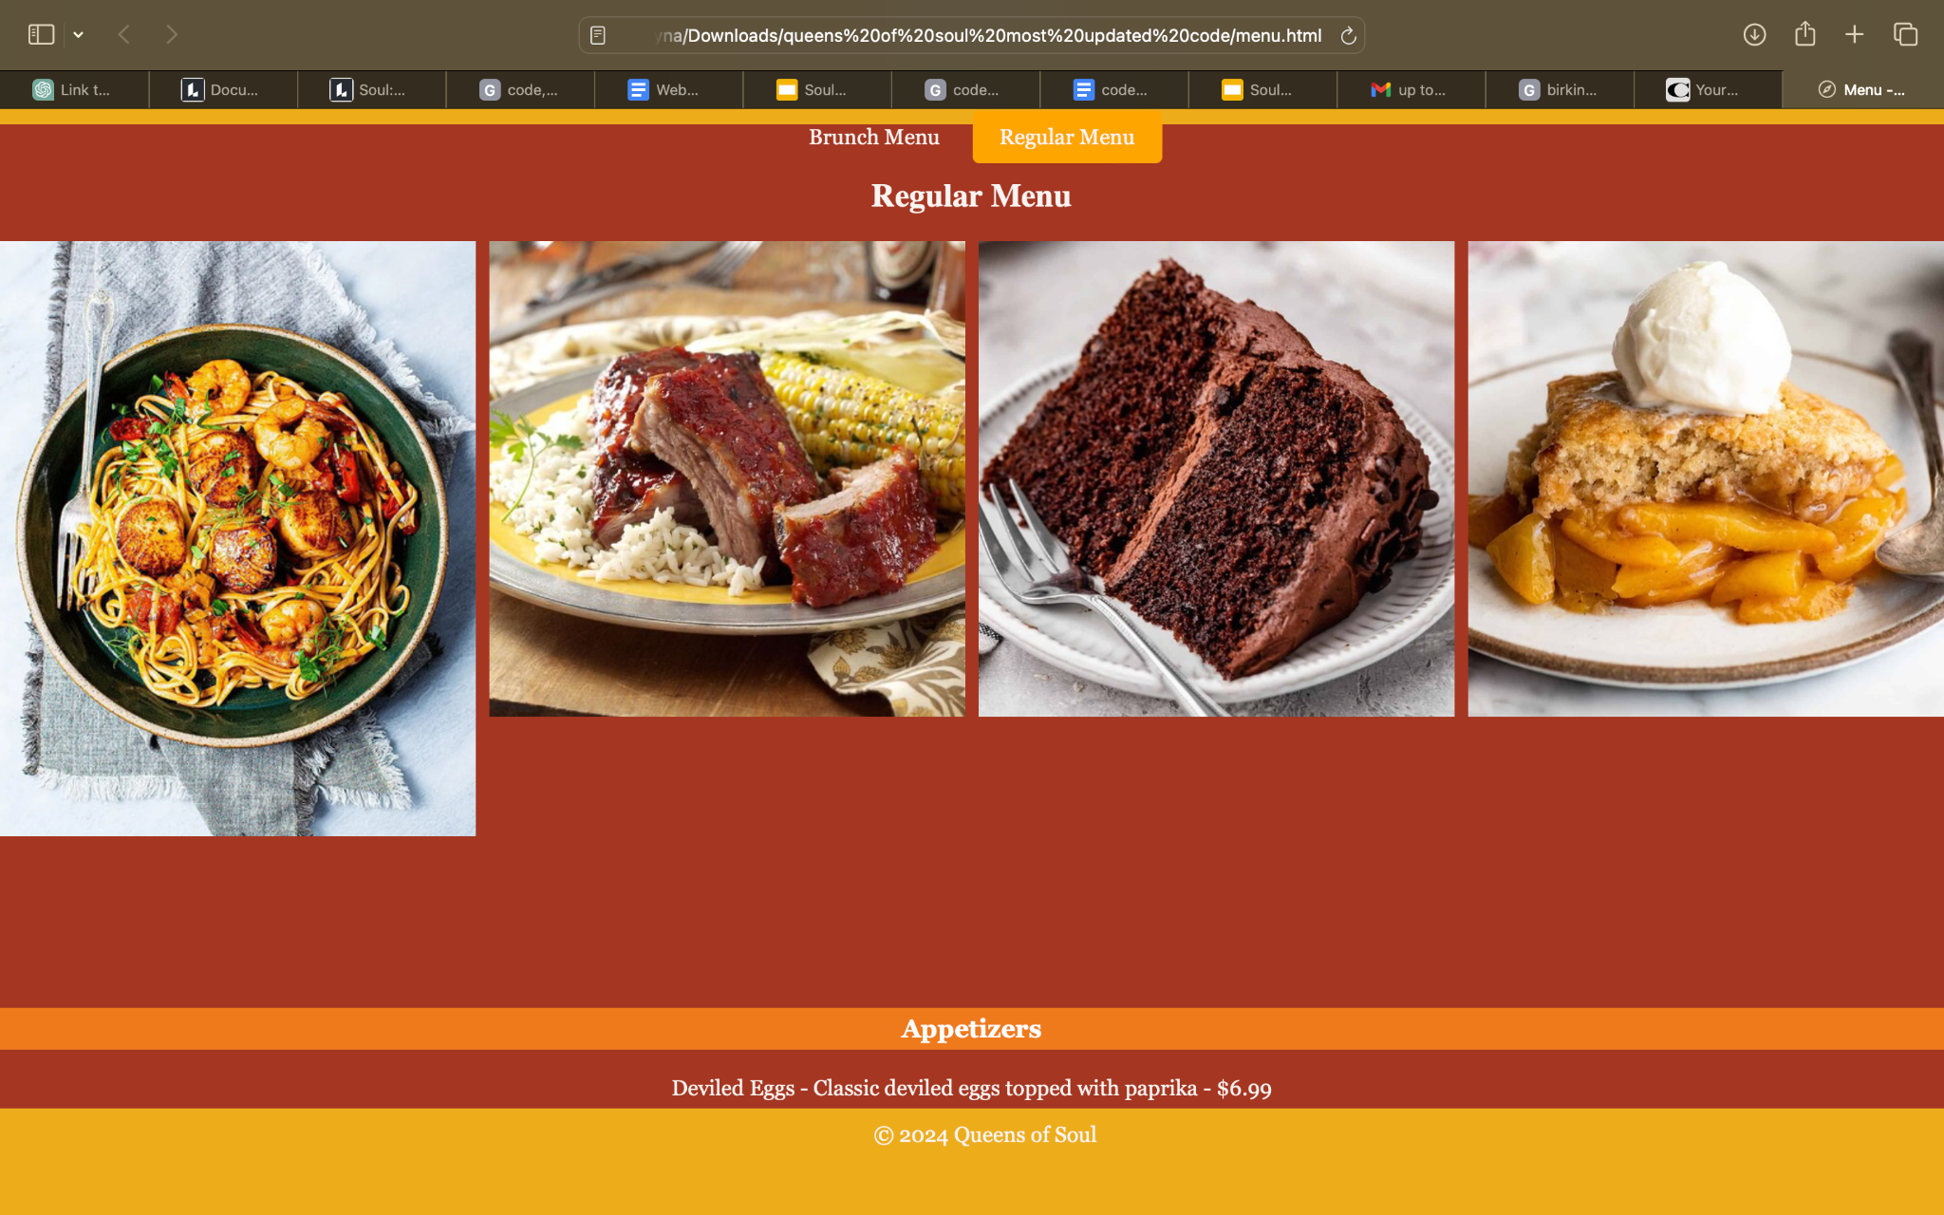
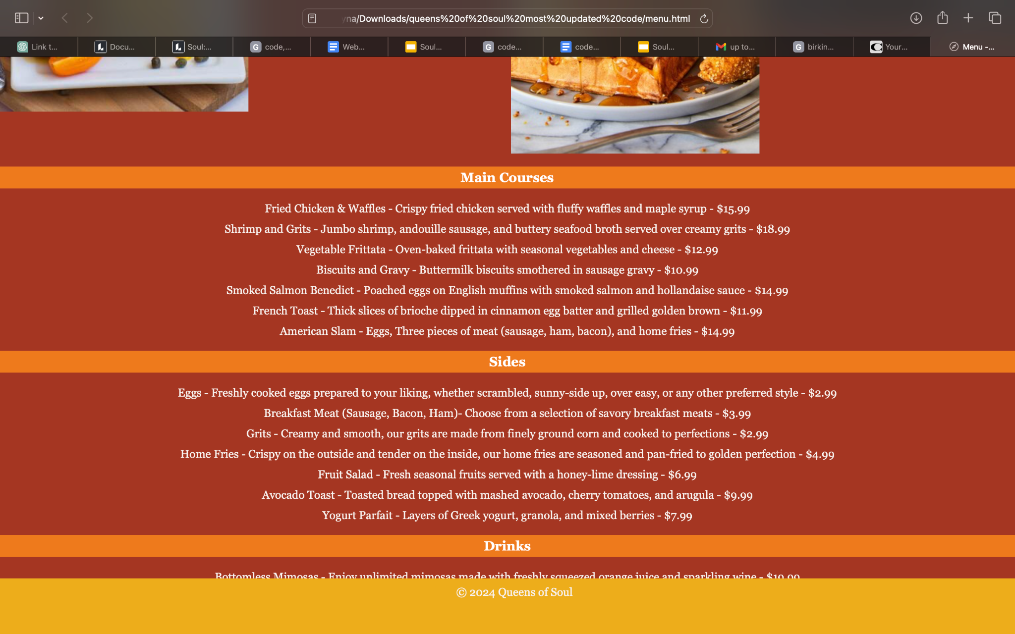
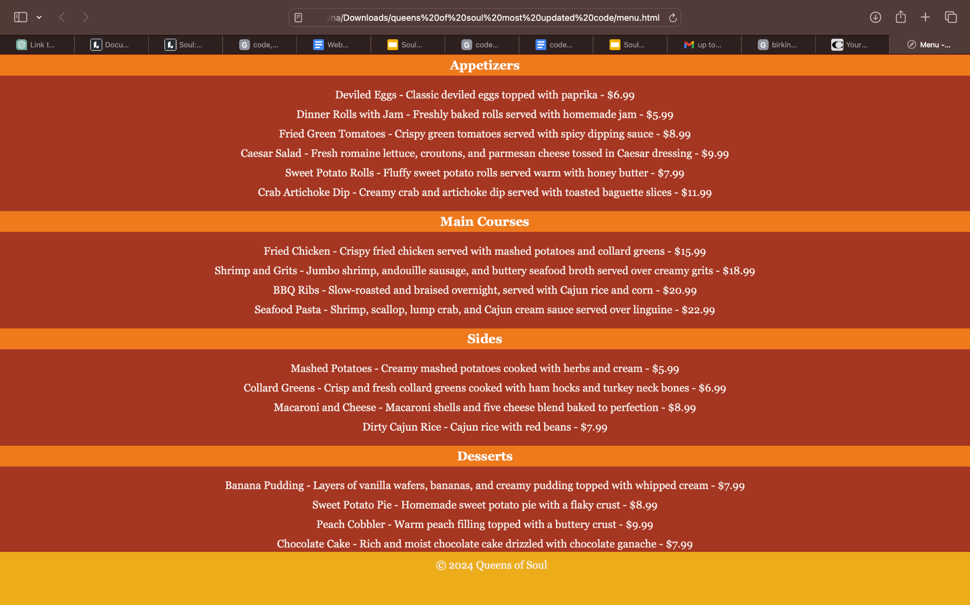
PAGE 2: Menus

Slide 12
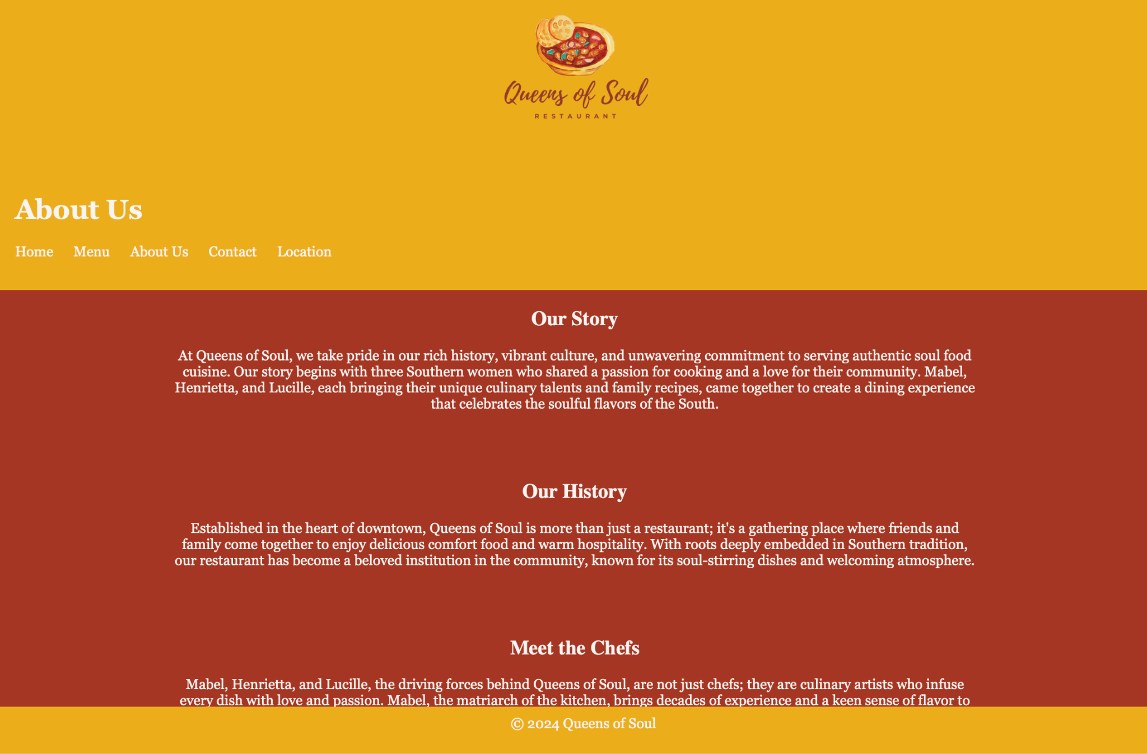
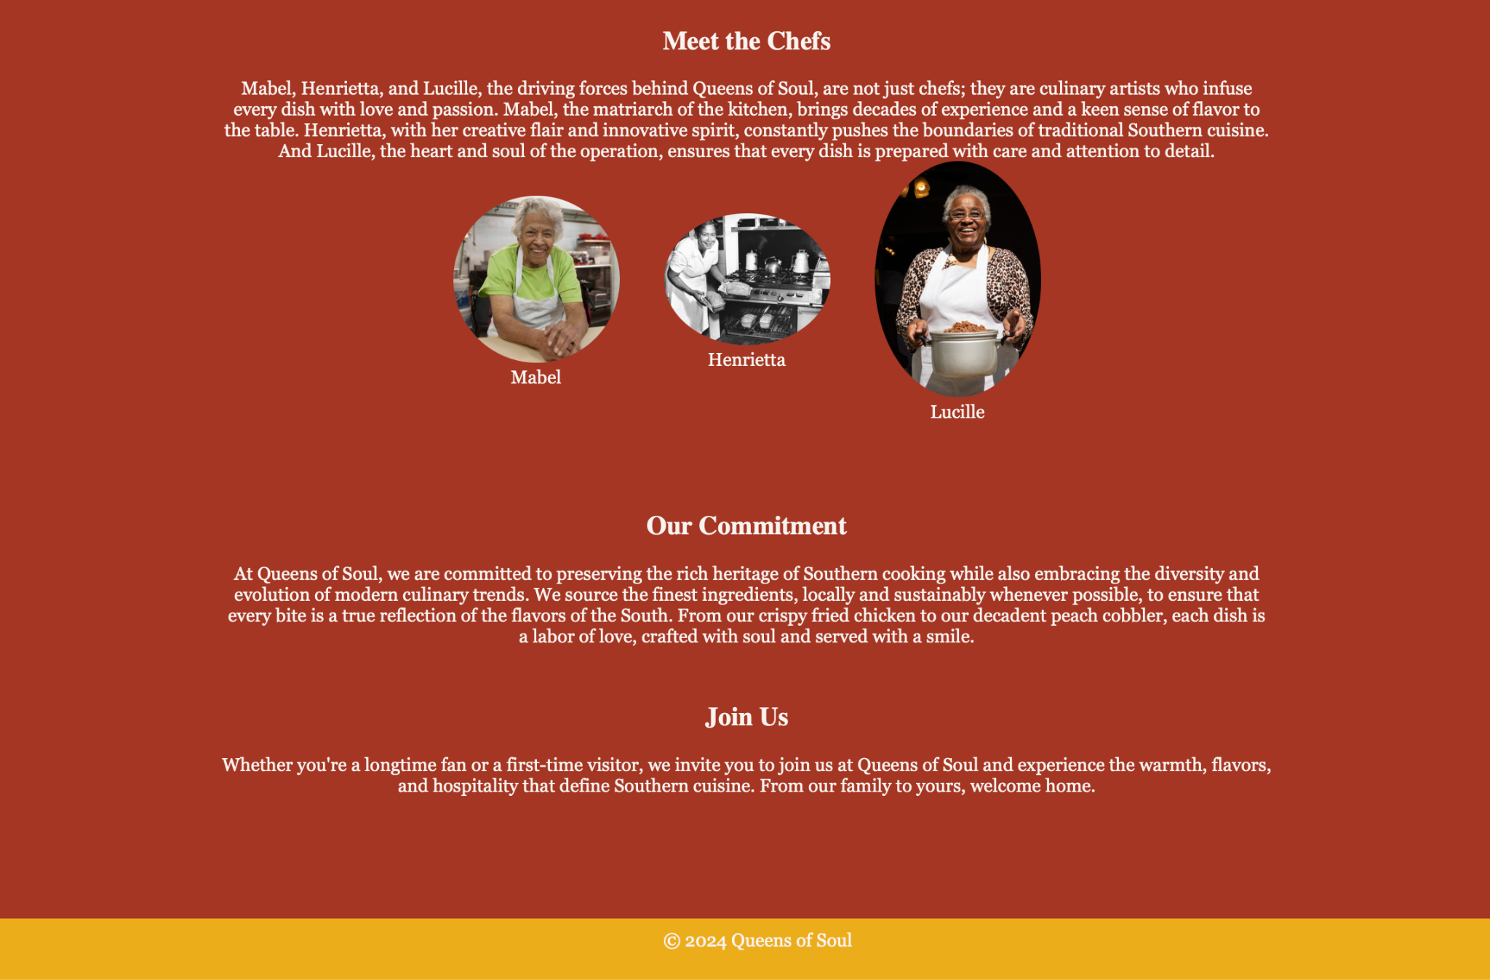
PAGE 3: About Us

Slide 13
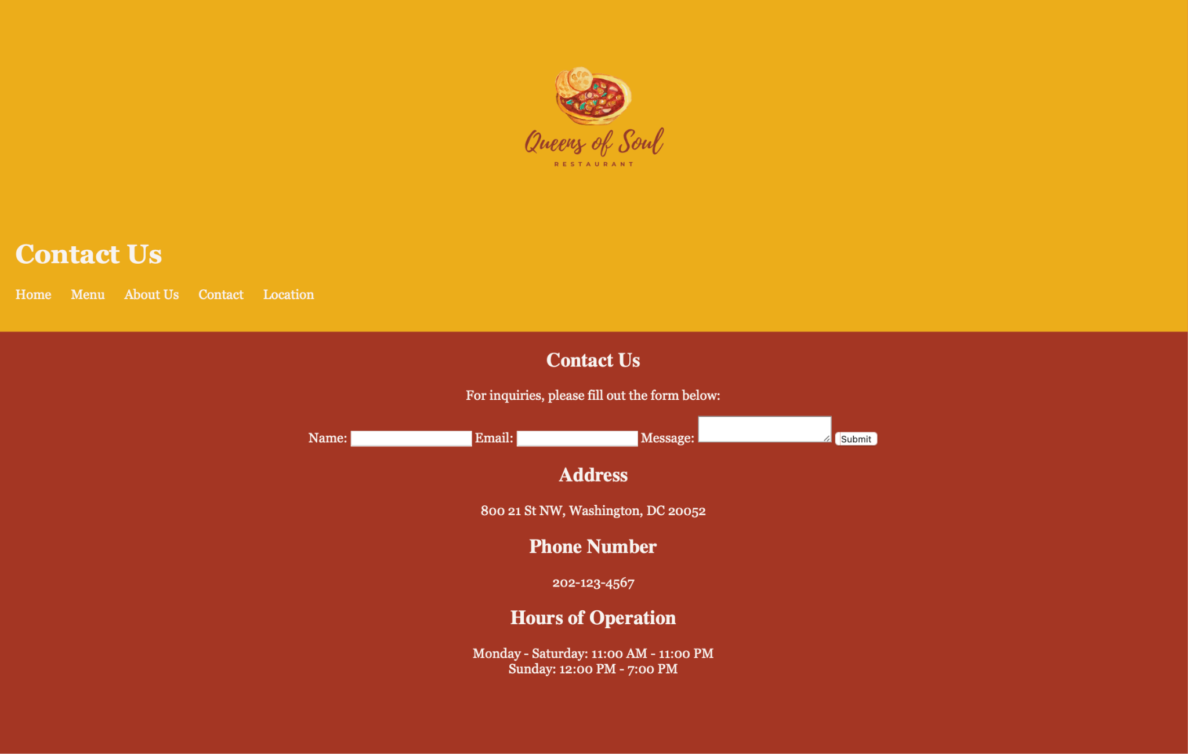
PAGE 4: Contact

Slide 14
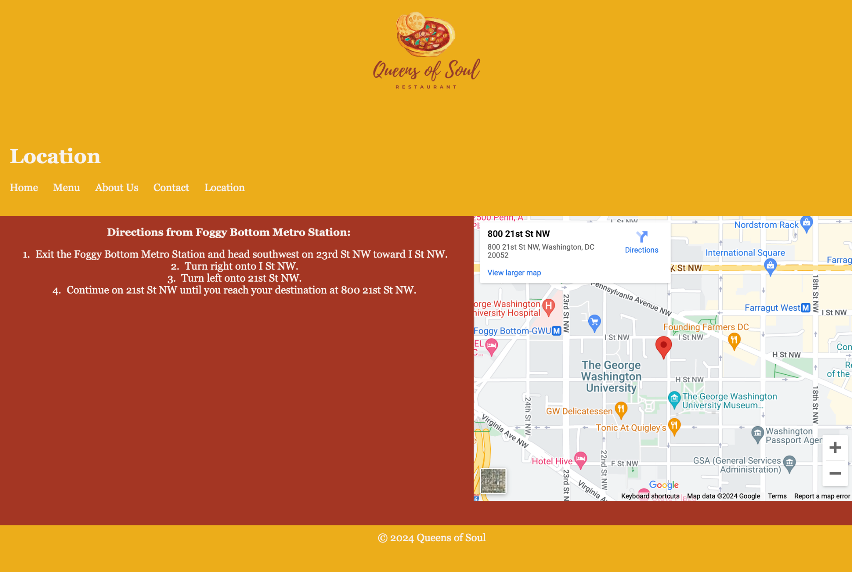
PAGE 5: Location

Slide 15
Implementation
and Reflection
HTML for structure, CSS for styling, and JavaScript for interactivity. Utilized libraries like Owl Carousel for dynamic features.
We succeeded in designing visually appealing pages and implementing smooth transitions. However, areas like form validation and responsive design need refinement.
Back to Agenda Page
Notes:
From the moment you step through our doors, you're greeted with warmth and hospitality, inviting you to indulge in the soulful delights that have captured the hearts of locals and tourists alike. we pave the way for an even more immersive experience through our forthcoming blog section and seamless reservation system, we invite you to join us on a culinary odyssey where every moment is infused with soulful magic. Looking ahead, Queens of Soul is committed to further elevating the dining experience through initiatives like a dedicated blog section and a user-friendly reservation system, ensuring guests can enjoy soulful cuisine with ease and delight.In our journey forward.

Slide 16
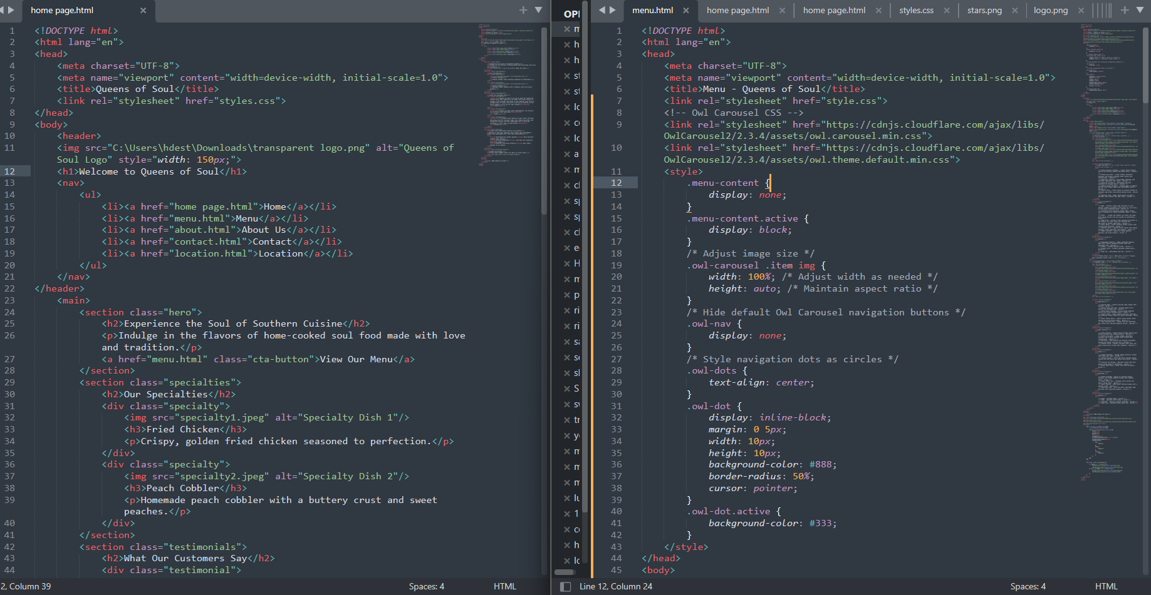
Code

Slide 17
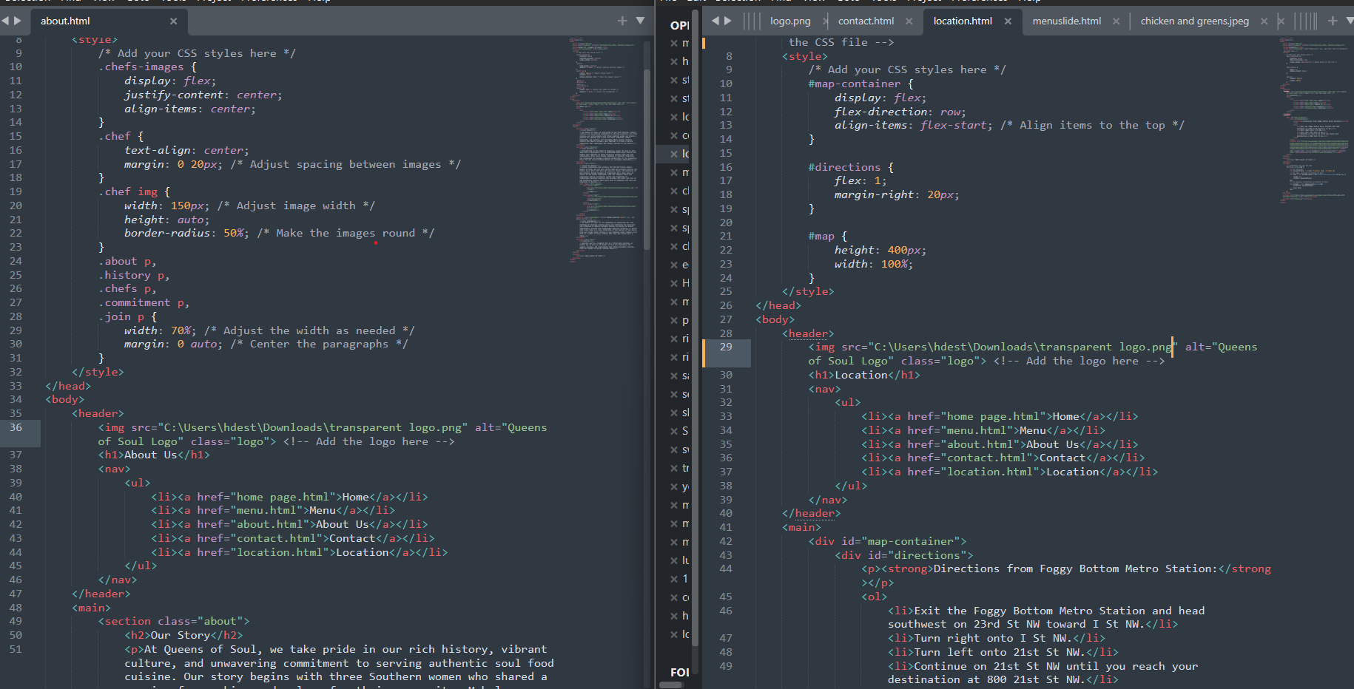
Code

Slide 18
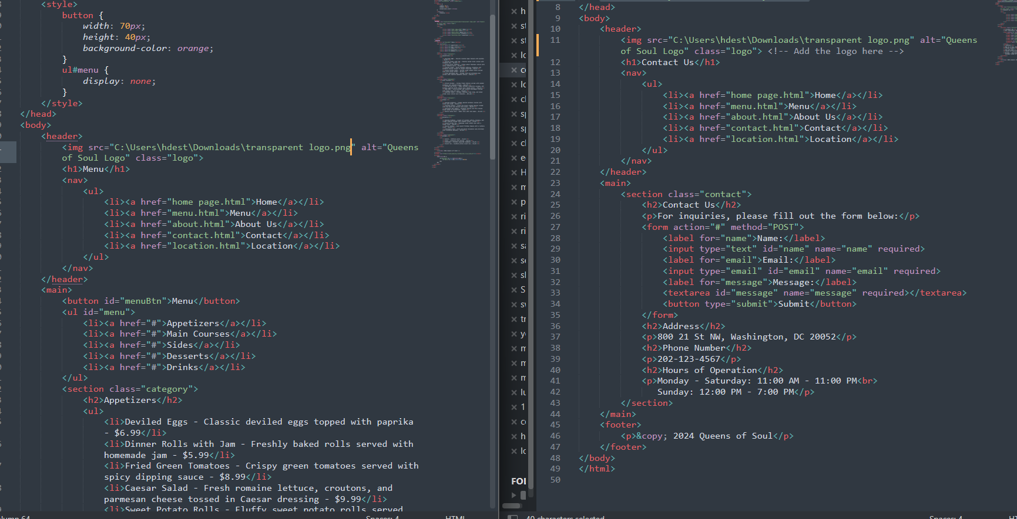
Code

Slide 19
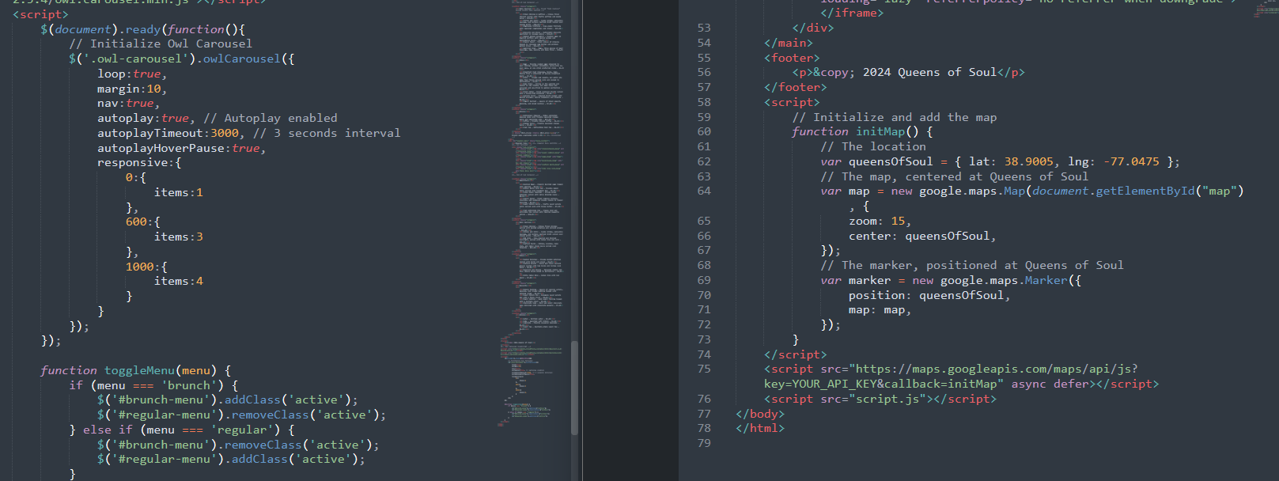
JS Code

Slide 20
Future Direction
Additional Features:
Online Bookings & Reservations of Tables
Online Food Ordering & Delivery Services
Blog Content: Recipes, Interviews, Events, etc.
Optimize for mobile and integrate social media for broader reach

Slide 21



Thank you!
Insert a parting or call-to-action message here.

